Slide 1
Major Project Report Presentation
TrafficWise: Analysis And Management System
Submitted by:
Khushi Mathur (20ETCCS063)
Archi Paneri (20ETCCS010)
Deepesh Choudhary (20ETCCS027)
4th year, 8th sem, CSE
Mentor:
Ms. Deepti Gour
Assistant Professor, CSE
Techno India NJR Institute of Technology

Slide 2
Problem Statement
The project aims to create a system that can accurately detect and recognize traffic signs, violation of traffic rules and vehicle number plates using computer vision techniques.
Group Member Details:
Khushi Mathur 20ETCCS063
Archi Paneri 20ETCSS010
Deepesh Choudhary 20ETCCS027

Slide 3
Objectives
The task of identifying motorcycle riders and number plates can be challenging due to various factors such as variations in lighting conditions, occlusions, and deformations. This problem has significant real-world applications, as accurate and efficient detection of motorcycle riders and number plates is critical for traffic management, law enforcement, and public safety.
The aim of the project is to develop APIs that can accurately and efficiently detect traffic signs and number plates from images, which can be integrated into various applications for practical use.
The primary objective of the project is to train machine learning models for traffic sign and number plate recognition with effective accuracy. The models will be developed using Convolutional Neural Networks (CNN) for traffic sign recognition and contour and Optical Character Recognition (OCR) techniques for number plate recognition.

Slide 4
Idea/Approach Details
Idea Solution/Prototype:
Project aim: Design and develop a system for traffic sign and vehicle number plate detection and recognition.
Image preprocessing: Required before object detection and recognition tasks.
Object detection: Using Faster CNN for traffic sign and number plate detection.
Traffic sign recognition: Using CNNs for image classification to recognize the type of traffic sign.
Speed detection: Using Computer Vision Techniques to detect the speed of the vehicles
Number plate recognition: Using OCR techniques to recognize characters on the number plate.

Slide 5
Abstract
Technology Stack
This project proposes a system for traffic sign and vehicle number plate detection and recognition using computer vision techniques in Python. The system involves collecting and preprocessing images, detecting traffic signs and number plates using object detection, recognizing the type of sign using image classification, and recognizing the characters on the number plate using OCR.
Frontend: React
Backend: Flask
Styling: Tailwind CSS
Vite tooling
Smart Cameras: IoT device to collect the images and detect traffic rule violations.

Slide 6
Project Requirements
Functional Requirements
Image Upload: The system should allow users to upload images of traffic signs and number plates.
Traffic Sign Detection: The system should be able to detect the presence of traffic signs in the uploaded images.
Traffic Sign Recognition: The system should be able to classify the type of traffic sign detected.
Number Plate Detection: The system should be able to detect the presence of number plates in the uploaded images.
Number Plate Recognition: The system should be able to recognize the characters on the number plate.
Non-Functional Requirements
Real-time Performance: The system should be able to perform detection and recognition tasks in real-time, ideally at a speed of at least 15 frames per second.
Accuracy: The system should have a high accuracy rate in detecting and recognizing traffic signs and number plates.
Scalability: The system should be able to handle a large number of image uploads and detection/recognition tasks simultaneously without compromising performance.

Slide 7
Scopes
The scope of the project involoves the deployment of intelligent CCTV cameras at key traffic intersections, integration with the traffic light system for real-time data capture, and the development of a cloud-based backend for data processing and analysis.
Future Scopes include:
Dynamic Traffic Signal Optimization Multi-modal Traffic Analysis Smart Route Planning Predictive Analytics Community Engagement Tools

Slide 8
Project Outcomes
Improved Security: By automatically monitoring and recording traffic signal violations, the system enhances overall security on the roads, contributing to a safer and more secure transportation environment.
Efficient Law Enforcement: The Traffic Management System reduces the burden on traffic police by automating the detection of traffic violations. This allows law enforcement agencies to allocate their resources more efficiently, focusing on more critical tasks.
Real-time Traffic Monitoring: The system provides real-time view of all the major intersections, the traffic conditions, etc. This information enables authorities to optimize traffic flow and implement measures to alleviate congestion.
Violation Tracking and Fines: The system keeps a record of the number of times a vehicle violates traffic signals. Offenders can be easily identified, and fines can be issued based on the captured license plate numbers. This promotes adherence to traffic regulations.

Slide 9
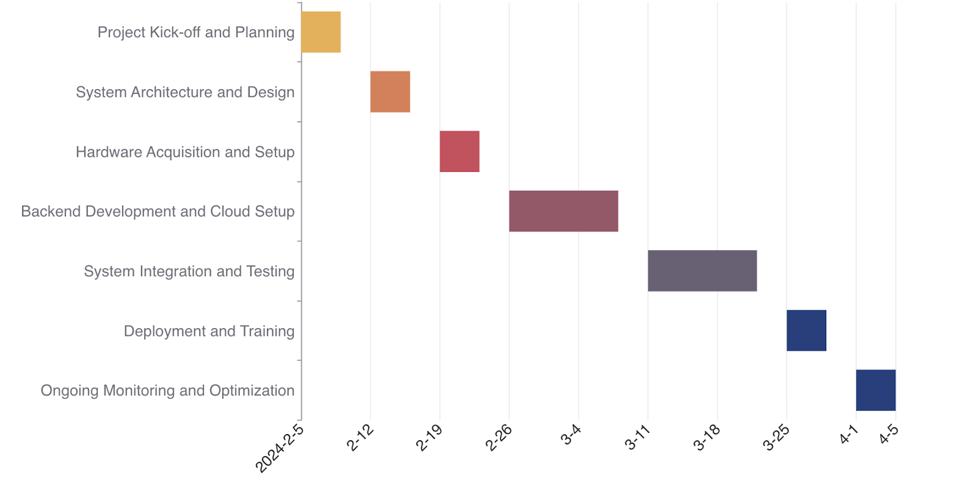
Project Timeline

Slide 10
Conclusion
In conclusion, the TrafficWise project offers a comprehensive solution to urban traffic management, leveraging advanced technologies and data analytics. Through iterative development and optimization, it delivers reliable services, with potential for further enhancements to improve mobility and safety in urban areas.

Slide 11
Bibliography
Websites
https://legacy.reactjs.org/
https://fastapi.tiangolo.com/
https://www.tensorflow.org/api_docs
https://keras.io/api/
https://getbootstrap.com/
https://numpy.org/
https://pandas.pydata.org/
https://matplotlib.org/

Slide 12
Thank you!

